Slide 1

End-To-End Data Pipeline For Heart Disease Prediction Using AWS
Project guide
Dr. Prabakeran S
Team Members
Akshay Kumar (RA2412033010021)
Akshay Ladha (RA2412033010035)
Ritesh Kumar Verma (RA2412033010024)

Slide 2

Contents
Introduction
Business Logic
AWS Services Used
Implementation Steps
Model Training & Prediction
Conclusion & Future Scope
Problem Statement
Architecture Diagram

Slide 3
Literature Review
S.No. | Paper Title | Abstract Summary | Research Gap
1 | Neural Networks vs Machine Learning Methods | Compares Logistic Regression, Decision Trees, SVM, and Neural Networks for heart disease prediction using standard patient datasets. | Limited focus on ensemble strategies and hybrid deep learning; lacks real-time deployment evaluation.
2 | Valvular Heart Disease with CNN-Based Residual Network | Uses PCG signals to train a CNN-based residual model, achieving 90.04% accuracy for valvular heart disease detection. | No benchmarking with other signal-processing models or cross-validation on diverse datasets.
3 | Machine Learning for Heart Disease Prediction | Applies various machine learning algorithms to structured patient health data for early diagnosis of heart disease. | Lacks integration with wearable sensor data or real-time health monitoring scenarios.
4 | Ensemble Methods for Heart Disease Prediction | Evaluates ensemble learning models like bagging and boosting using various data mining tools for accurate prediction. | Insufficient analysis of model interpretability and clinical deployment constraints.
5 | Machine Learning and Deep Learning for Heart Disease | Presents ML and DNN techniques aimed at improving diagnostic accuracy in predicting heart disease using historical health data. | No consideration of federated or privacy-preserving learning frameworks in healthcare environments.

Slide 4
Research gap
Lack of end-to-end automation in traditional data pipelines.
Minimal integration of real-time monitoring with machine learning workflows.
Inconsistent data preprocessing standards in existing systems.
Underutilization of cloud-native tools like AWS Glue and SageMaker in academic and enterprise use cases.
Need for scalable, cost-effective solutions that ensure security and observability.

Slide 5
Problem Statement
Manual data processing is time-consuming and prone to human error, leading to inefficiencies in workflow execution.
Inconsistent and inefficient data transformation and integration across diverse platforms hampers data usability.
Delayed insights and decision-making due to sluggish data handling and lack of real-time processing capabilities.

Slide 6
Proposed Methodology
Data Ingestion
AWS S3 is used to store raw heart disease-related data securely.
1
Data Cataloging
AWS Glue Crawlers automatically detect schema and prepare a catalog for transformation.
2
Data Transformation
AWS Glue ETL jobs clean, transform, and prepare the data for modeling.
3
Model Training & Evaluation
Vertex AI is used to train and evaluate machine learning models on the processed data.
4
Model Deployment
The trained model is deployed using Vertex AI endpoints for real-time inference.
5
Dashboard Hosting
An AWS EC2 instance hosts a Streamlit dashboard for heart disease prediction, allowing users to input data and receive real-time predictions.
6

Slide 7
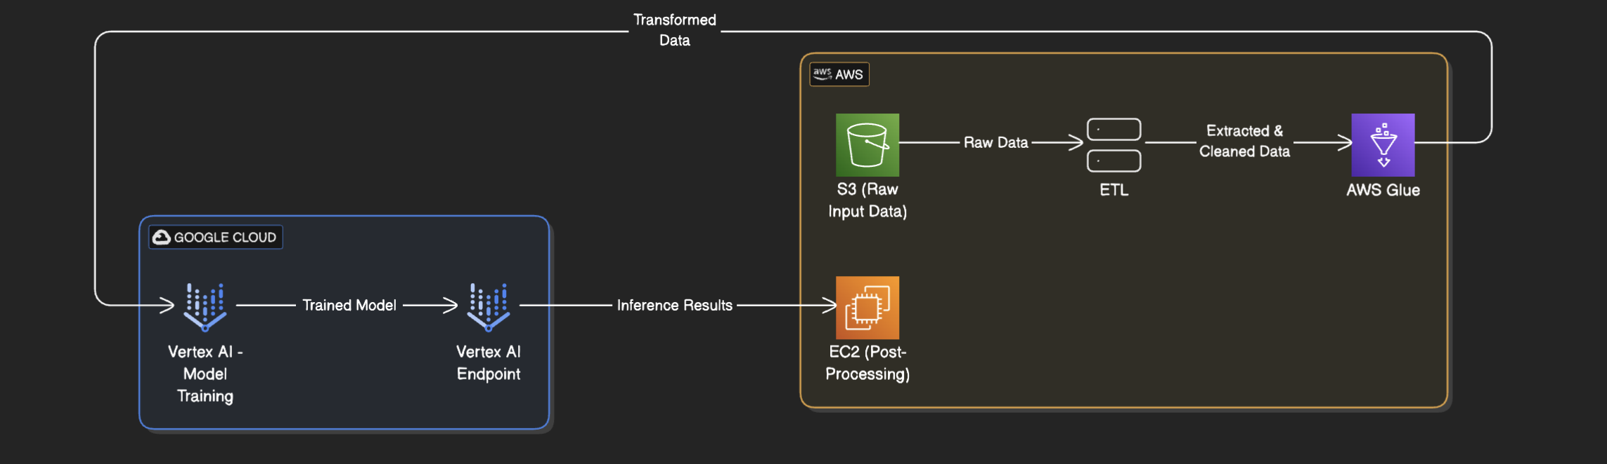
Proposed Architecture

Slide 8

Module Explaination
Data Ingestion (AWS S3):
Raw health data (CSV, JSON, etc.) is uploaded to S3 buckets which act as the centralized storage layer for the project.
Data Cataloging (AWS Glue Crawler):
Glue Crawlers scan the S3 bucket and automatically catalog the dataset, creating a metadata table in the AWS Glue Data Catalog.
Data Transformation (AWS Glue ETL):
Glue ETL jobs are used to clean, normalize, and transform the data into a format suitable for machine learning.
Model Development (Amazon SageMaker):
Using Vertex AI, machine learning models are trained on the processed data to predict heart disease risks. The predictions are then visualized through a Streamlit app hosted on an EC2 instance, where users can interact with the model and view results in real-time.
A user-friendly Streamlit dashboard, hosted on an EC2 instance, visualizes prediction results by calling the SageMaker model endpoint in real time.

Slide 9
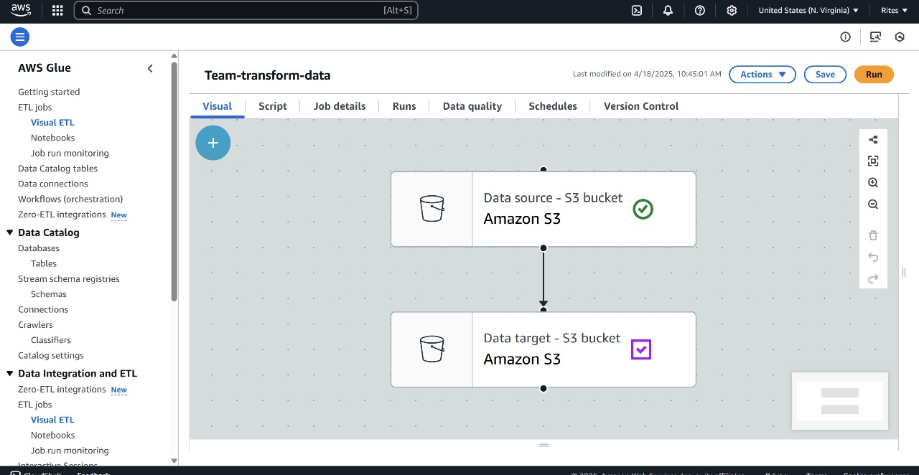
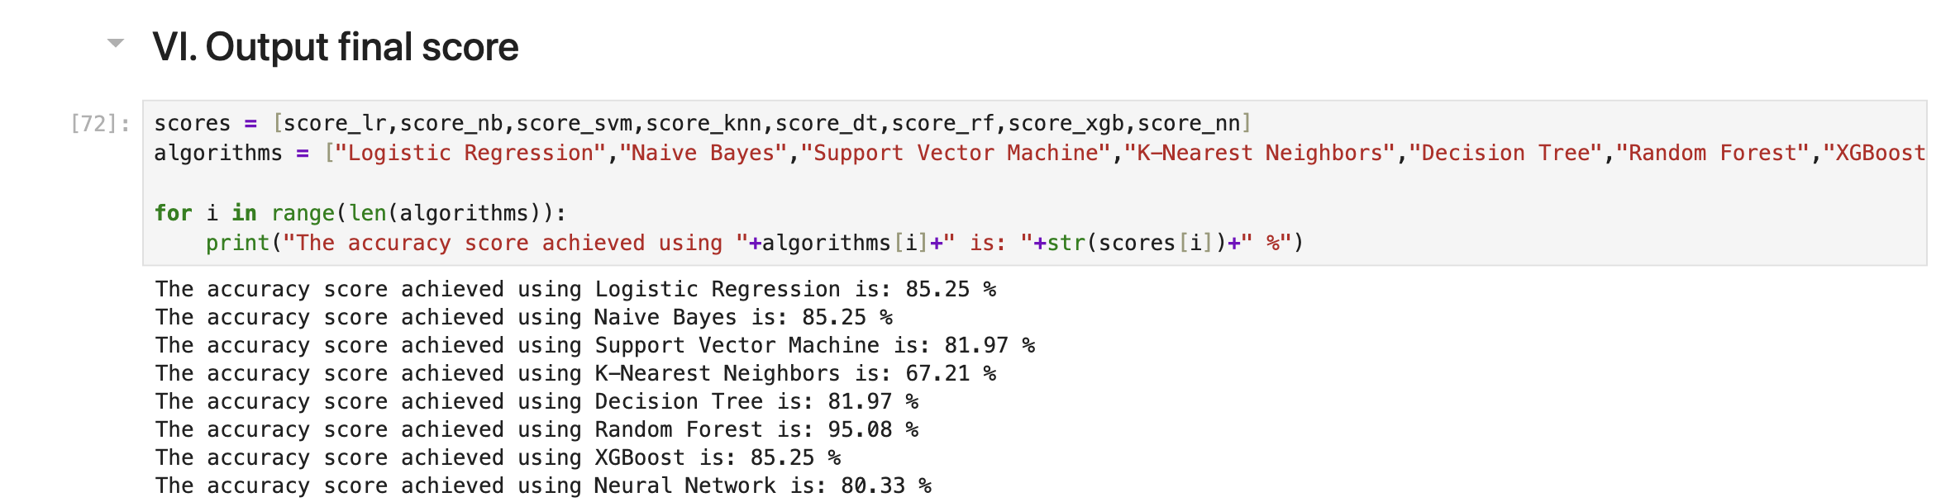
Sample of screenshot

Slide 10
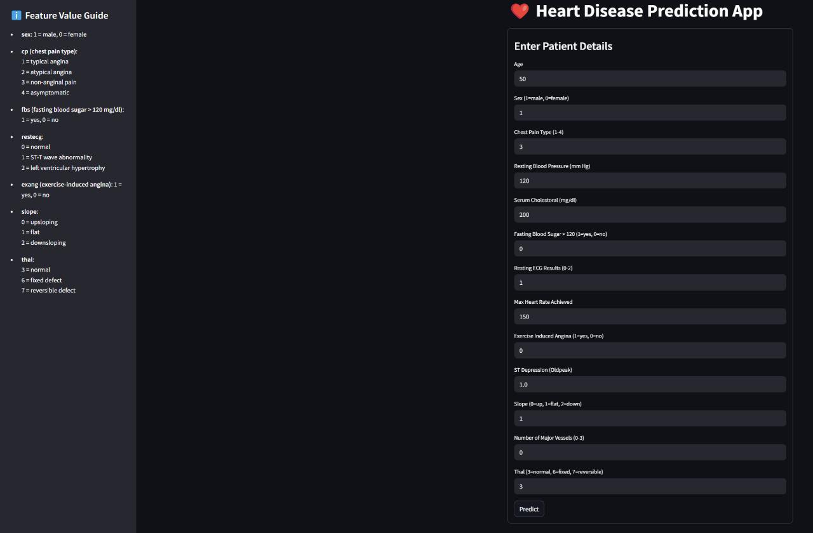
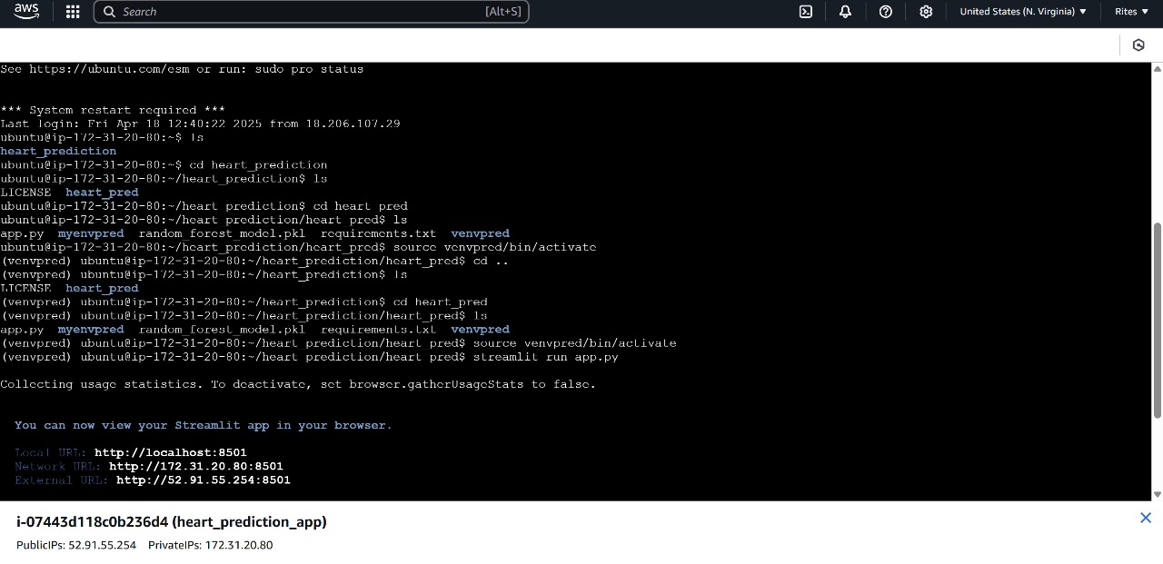
Sample of screenshot

Slide 11
Outcome
Successfully built an end-to-end automated machine learning pipeline using AWS services for heart disease prediction.
Raw health data is automatically ingested, cleaned, and transformed using S3 and Glue without manual intervention.
Machine learning model is trained and deployed using Amazon SageMaker for real-time prediction.
Streamlit dashboard hosted on EC2 allows users to interactively input health data and receive instant predictions.
Scalable and secure architecture that can handle large volumes of health data and extend to other prediction use cases.

Slide 12
Reference
Neural Networks vs Machine Learning Methods
DOI: 10.1109/ICCT57144.2023.10076174
Valvular Heart Disease with CNN-Based Residual Network
DOI: 10.1109/ICST59744.2023.10460788
Machine Learning for Heart Disease Prediction
DOI:10.1109/TEMSCONASPAC59527.2023.10531380
Ensemble Methods for Heart Disease Prediction
DOI: 10.1109/UEMCON59035.2023.10315997
Machine Learning and Deep Learning for Heart Disease
DOI: 10.1109/ICCT57144.2023.10055902

Slide 13

Thank you

